Slide 1




INTRODUCTION
This data visualization project dives into the heart of the Cricket World Cup by exploring player statistics. Unveiling trends and hidden stories, we'll see who reigns supreme with the bat, dominates with the ball, and becomes a World Cup legend.
DONE BY:
TANISHQ RATDIYA (23070126133)
TANNIRU HARI SRI (23070126135)
TOM THOMAS(23070126136)

Slide 2
OBJECTIVE:
This project aims to:
Gather comprehensive player statistics from the Cricket World Cup.
Clean and transform the data to facilitate analysis.
Design interactive visualizations within Power BI to showcase player performance.
Empower users to explore and compare player statistics across teams, positions, and various metrics.
Offer a valuable tool for cricket fans and analysts to gain deeper understanding of player performance within the World Cup.

Slide 3
METHODOLOGY
DOWNLOADING IN FORM OF .CSV FILES
THE DASHBOARD
WEB SCRAPPING
Design interactive visualizations like bar charts, line graphs, or tables to showcase player statistics. Consider using appropriate chart types based on the data being presented (e.g., bar charts for comparisons, line graphs for trends).
Design a visually appealing and user-friendly dashboard layout
We had alo used dash measures.
Develop scripts to navigate the website and extract relevant player data. This may include names, nationalities, batting/bowling averages, wickets taken, etc.
Once the data is clean and transformed, export the Pandas dataframe into multiple CSV files for better organization within Power BI.
Each CSV file could represent a specific data category, such as batting stats, bowling stats, or player profiles
2
4
6
1
3
5
GETTING DATA
TRANSFORMING DATA
UPLOAD THE .CSV FILES INTO POWER BI
Identify a reputable website that provides comprehensive Cricket World Cup player statistics. Examples include ESPNcricinfo, Cricbuzz, or the official ICC website.
Analyze the website structure to locate the specific sections containing player stats. This might involve player profiles, leaderboards, or match reports.
Import the scraped data into a Pandas dataframe.
Clean the data by handling missing values, inconsistencies in formatting (e.g., converting strings to numeric data types), and removing irrelevant information.
Explore data manipulation techniques like grouping players by teams, calculating batting/bowling averages, or identifying top performers.
Open Power BI Desktop and import the prepared CSV files.
Establish relationships between tables based on common fields (e.g., player ID) to enable seamless data analysis.

Slide 4
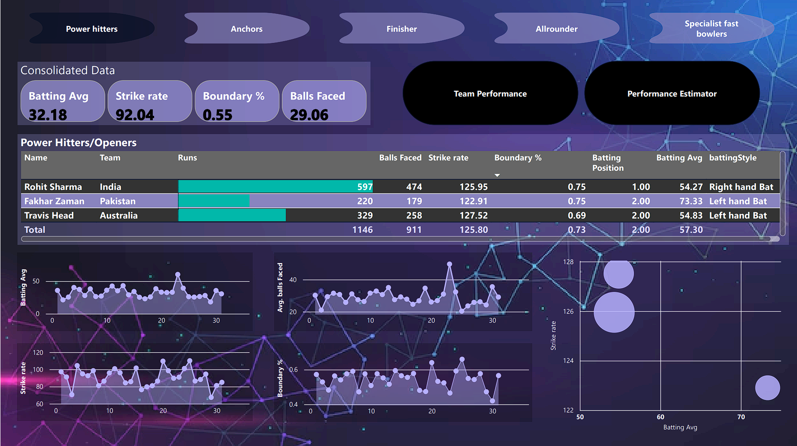
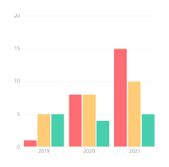
DASH BOARD IMAGES:

Slide 5
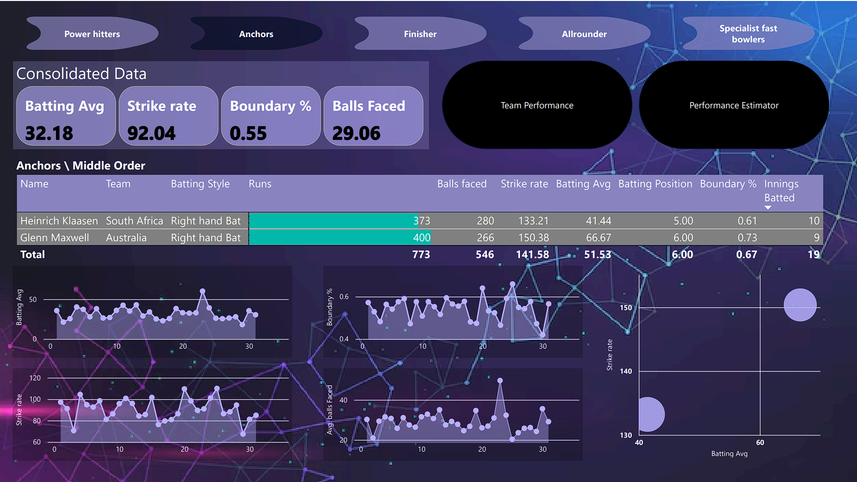
DASH BOARD IMAGES:

Slide 6
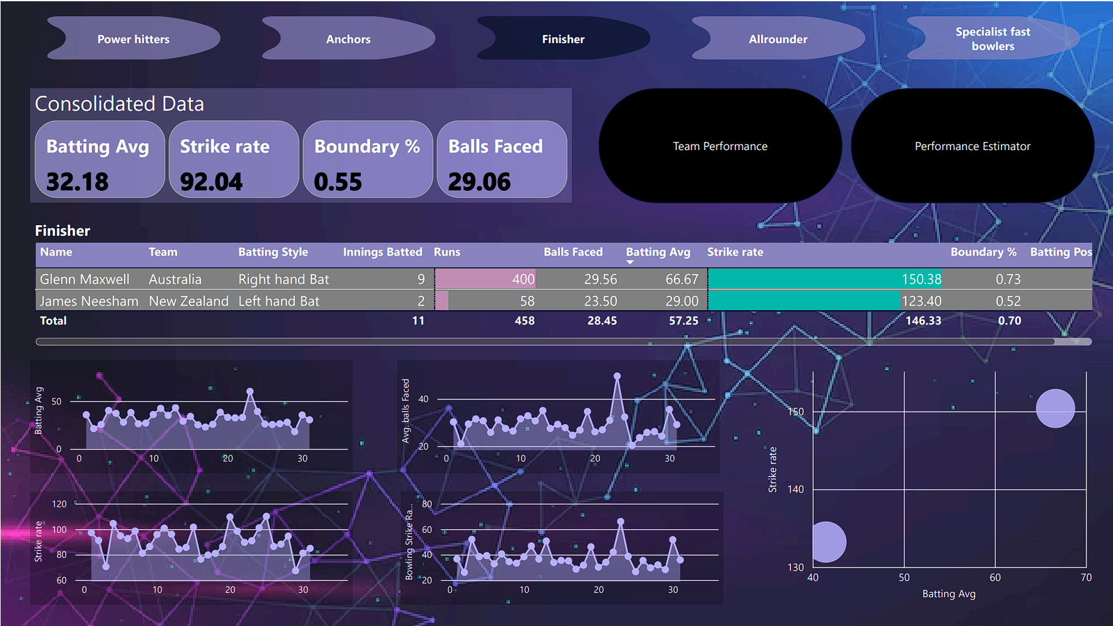
DASH BOARD IMAGES:

Slide 7
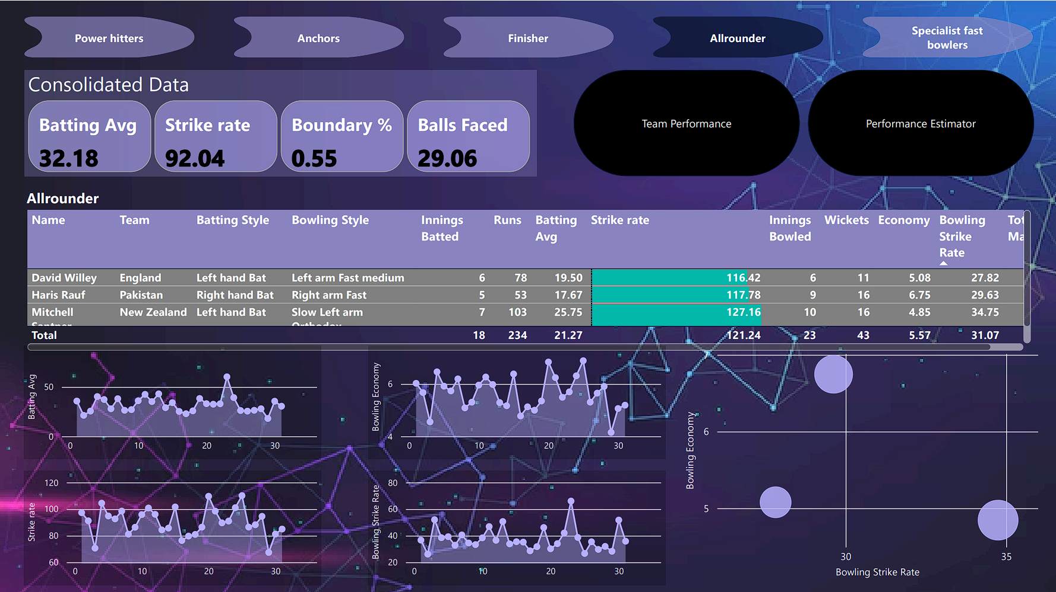
DASH BOARD IMAGES:

Slide 8
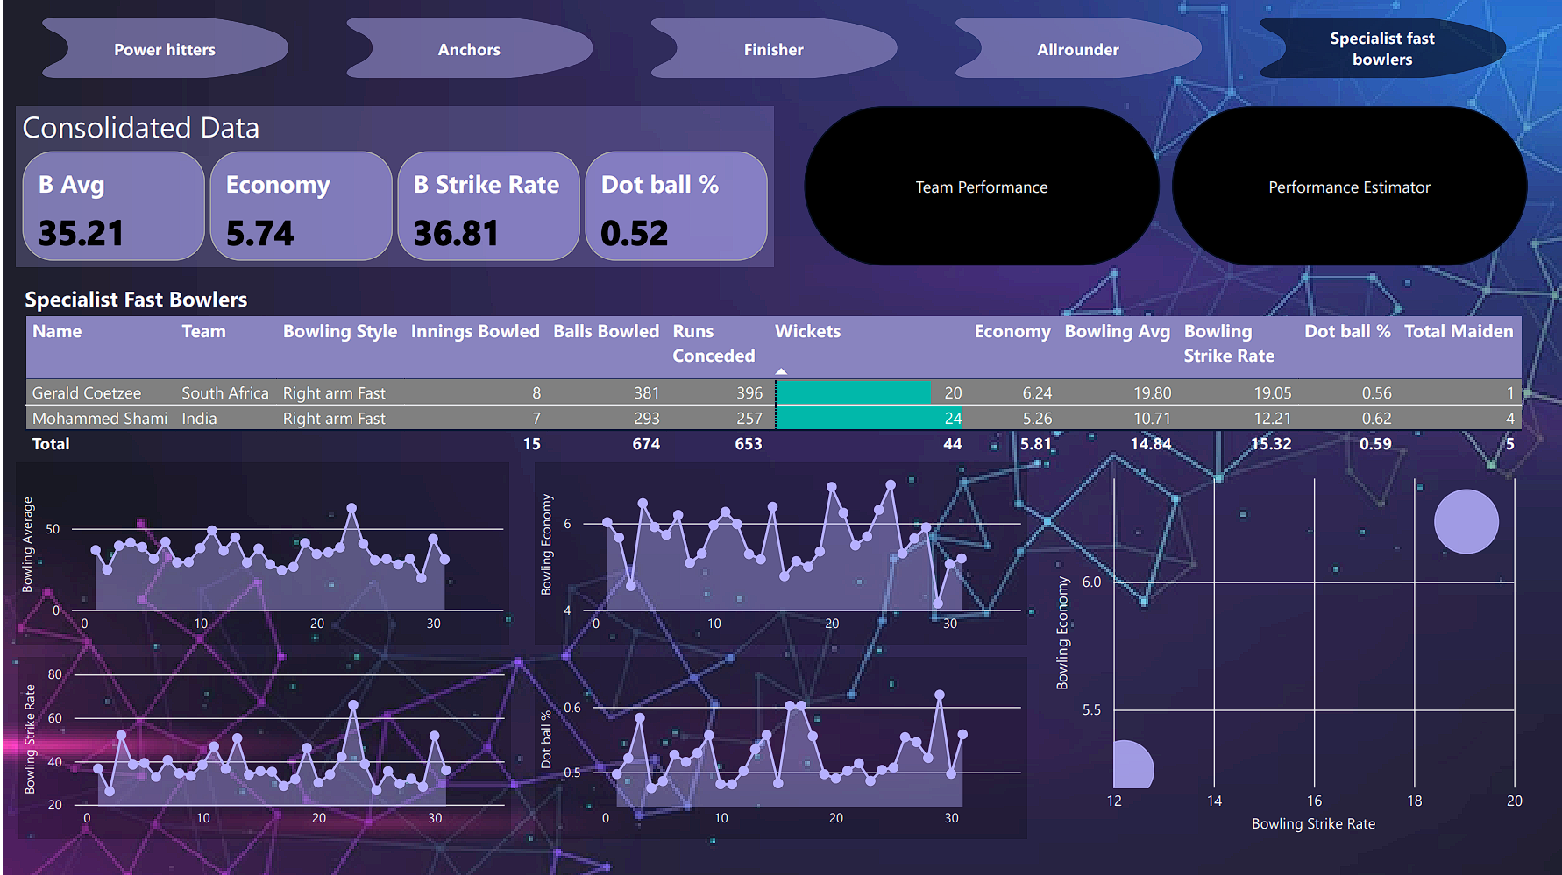
DASH BOARD IMAGES:

Slide 9
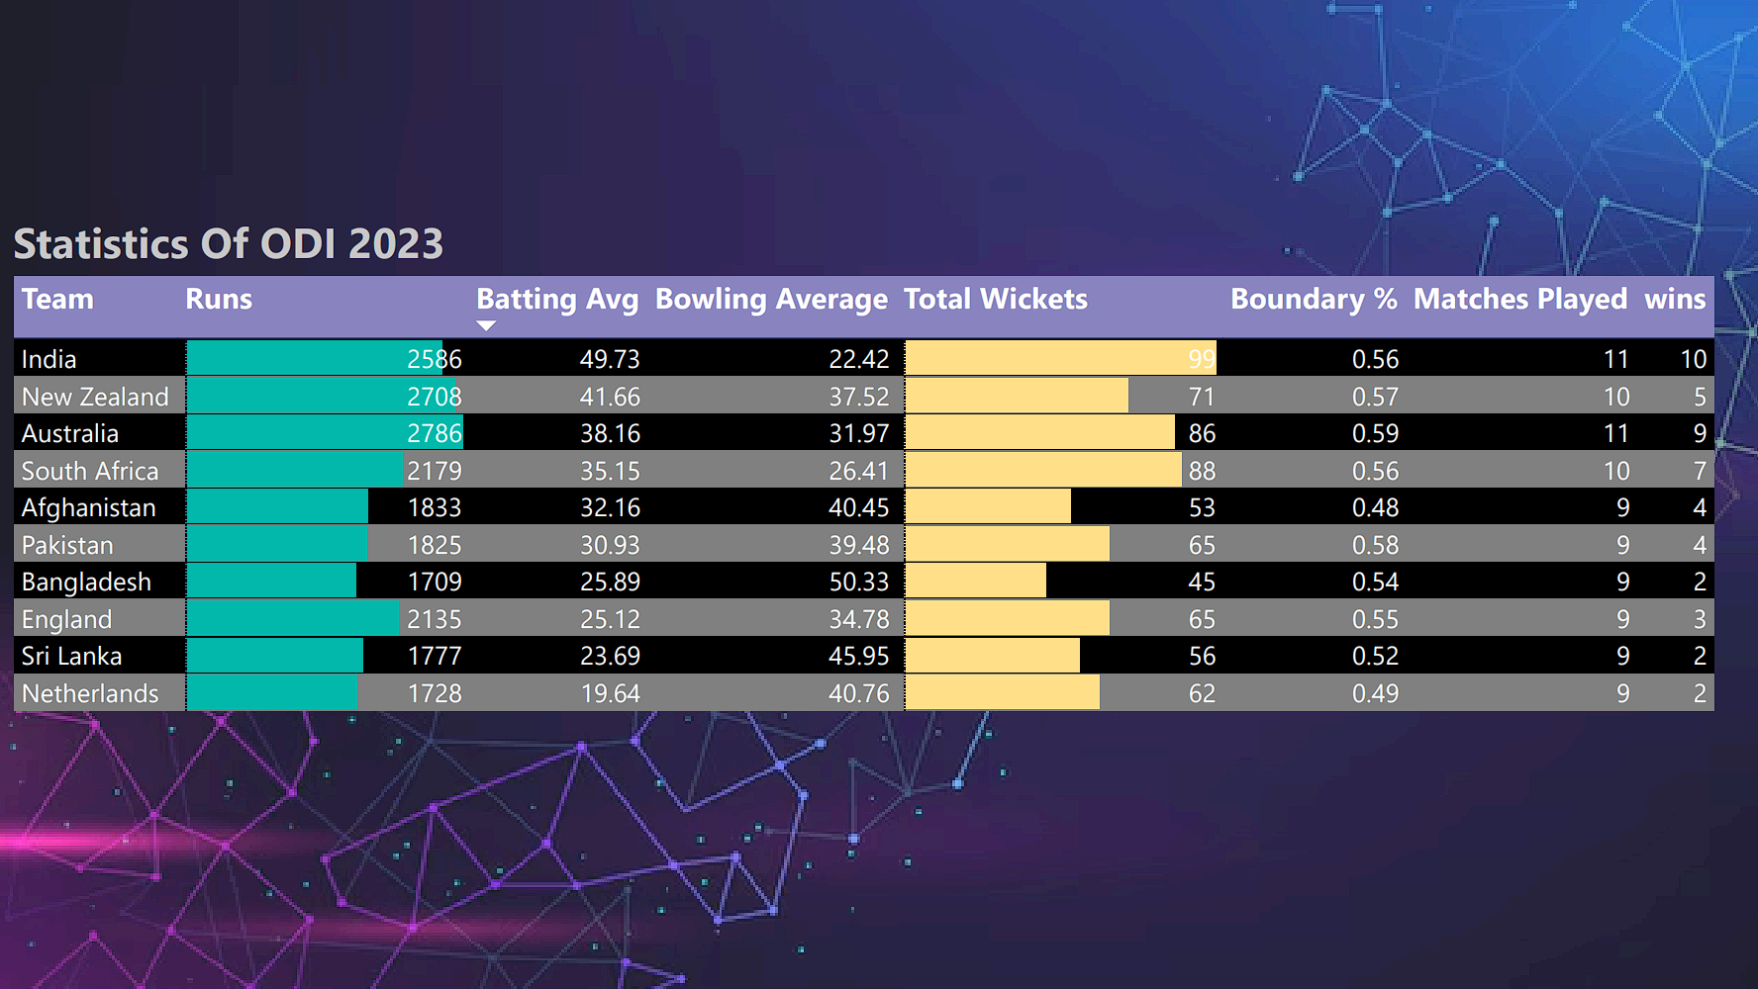
DASH BOARD IMAGES:

Slide 10
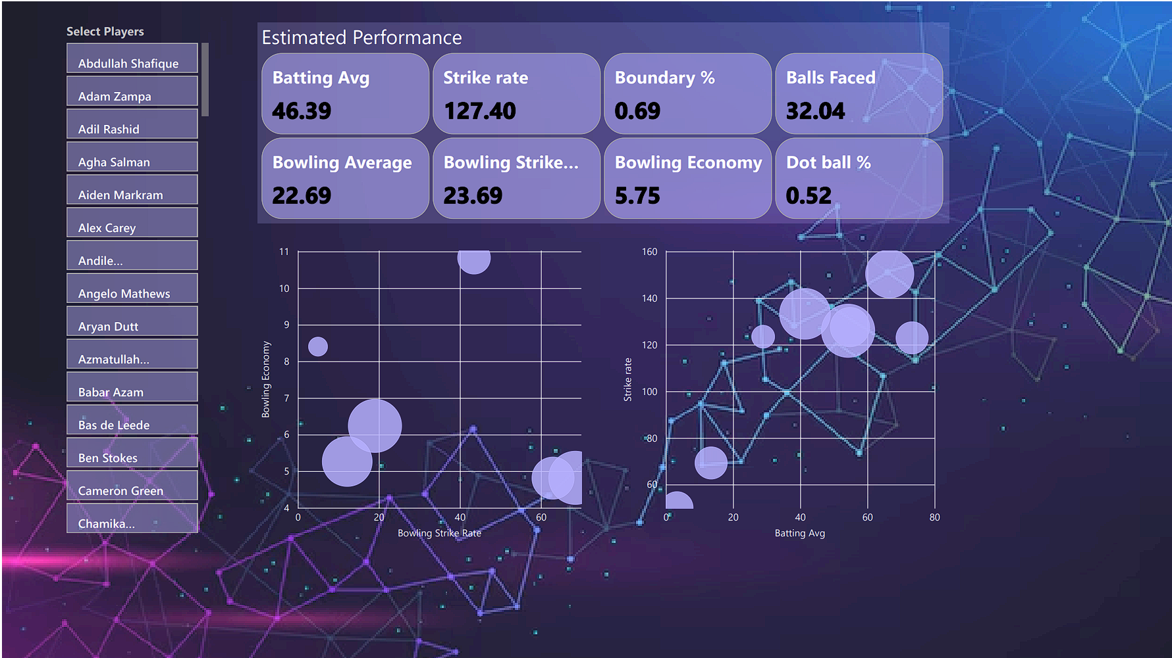
DASH BOARD IMAGES:

Slide 11
CONCLUSION:
This data visualization project successfully utilized web scraping and data manipulation techniques to create a comprehensive Power BI dashboard showcasing Cricket World Cup player statistics. By leveraging interactive visualizations and filtering options, the dashboard allows users to explore player performance across various metrics, fostering deeper insights into the tournament. This project demonstrates the value of data visualization in transforming raw statistics into a compelling and informative narrative for cricket enthusiasts.
Additionally, exploring predictive analytics could unveil emerging trends and potential player breakouts in upcoming tournaments.

Slide 12


TOOLS USED:
POWER BI
PYTHON

Slide 13
REFRENCES :
YOUTUBE LINK
https://youtu.be/4QkYy1wANXA?si=gjyc3v7QNxLRD2AS
DATASET
https://www.espncricinfo.com/records/tournament/icc-cricket-world-cup-2023-24-15338

